Slide 1


ALGORITHM FOR SAFETY AND DISTANCE OPTIMIZATION ON ROUTES IN MEDELLÍN

Slide 2


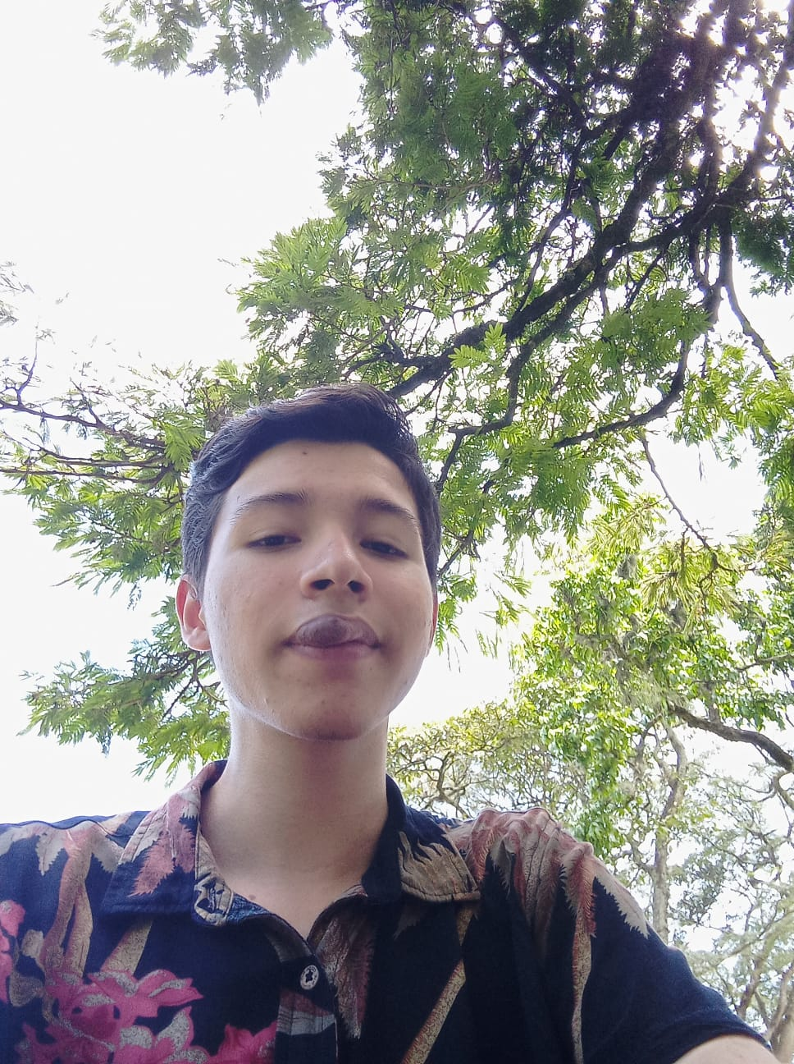



Presentation of the team
Sharif Velásquez
Investigator algorithms
Andrés Parra
Articles review
Andrea Serna
Literature review
Mauricio Toro
Data preparation
https://github.com/SharifVelasquezAlzate/SafetyAndDistanceOptimization

Slide 3

Problem Statement
Shortest path algorithm
Streets
of Medellín, Origin and Destination
Three paths that reduce both the risk of harassment and distance

Slide 4
Solution Algorithm
A* (A star)
Streets
of Medellín, Origin and Destination
A path that reduces both distance and harassment

Slide 5
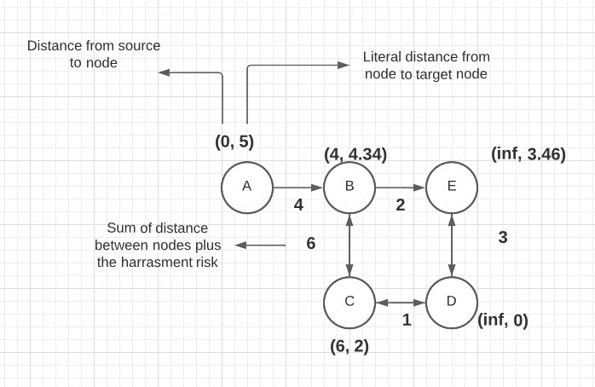

Explanation of the algorithm
Name of the algorithm: A*
A heuristic way to find best path

